Slide 1
City Auditor’s Office
Quarterly Report to Finance/Executive Committee
March 29, 2023

Slide 2
FY23 Summary
Audits
Follow-up
Continuous audit
5 audits released
12 audits in progress
Updating risk assessment for FY24 annual audit plan
74 Recommendations Closed
67 (91%) of 74 Closed as Implemented
49 Advanced Access Control Conflict Pairs
13 Sensitive Access
25 Financial & HR Transactions
3 OTBI Reports
https://dashboard.missionmark.com/ae075fd7-a40b-489c-a67a-6e1ec4566694/

Slide 3
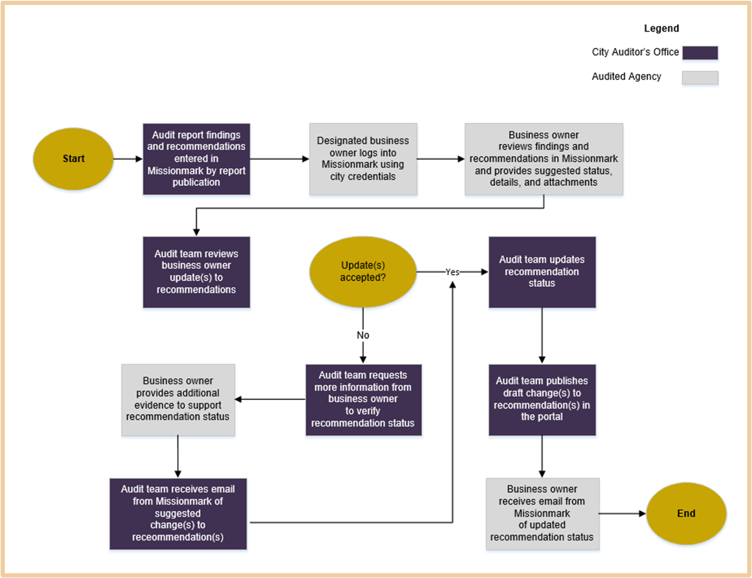
Audit Follow-Up Process

Slide 4
Audits Completed
Audit | Status
Beltline Special Services District | Released Oct 2022
Citywide Cash Handling | Released Oct 2022
Employee Benefits | Released Oct 2022
AFRD Financial Procedures | Released Oct 2022
Municipal Market Lease | Released Feb 2023
In Rem Process | Audit Committee
Solid Waste Services | Audit Committee
Grants Management | Audit Committee
9. Business License Administration | Audit Committee

Slide 5
Audits In Progress
Audit | Status
Oracle Time and Labor | Interim Report to Mgt; Ongoing review
Plane Train | Management Review and Response
Aviation Capital Projects | Fieldwork
Landscape Contracts | Fieldwork
Moving Atlanta Forward | Fieldwork
Water & Sewer Billing and Collections | Fieldwork
Municipal Court | Fieldwork
Procurement Cycle Time | Fieldwork

Slide 6
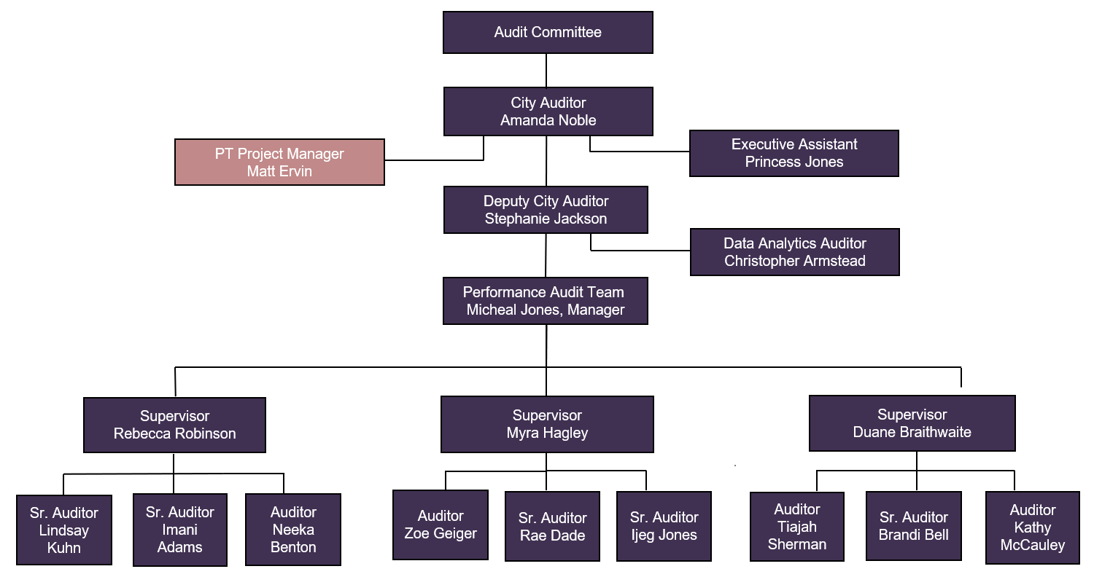
Organizational Chart

Slide 7
Questions?

