Slide 1
City Auditor’s Office
Quarterly Report to Finance/Executive Committee
July 12, 2023

Slide 2
FY23 Summary
Audits
Follow-up
Continuous audit
9 audits released
9 audits in progress
Updating risk assessment for FY24 annual audit plan
105 Recommendations Closed
96 (91%) of 105 Closed as Implemented
49 Advanced Access Control Conflict Pairs
13 Sensitive Access
25 Financial & HR Transactions
3 OTBI Reports
https://dashboard.missionmark.com/ae075fd7-a40b-489c-a67a-6e1ec4566694/

Slide 3
Audits Completed
Audit | Status
Beltline Special Services District | Released Oct 2022
Citywide Cash Handling | Released Oct 2022
Employee Benefits | Released Oct 2022
AFRD Financial Procedures | Released Oct 2022
Municipal Market Lease | Released Feb 2023
In Rem Process | Released April 2023
Solid Waste Services | Released April 2023
Grants Management | Released April 2023
Business Licenses | Released June 2023; Presenting to City Council in early August

Slide 4
Audits In Progress
Audit | Status
Oracle Time and Labor | Interim Report to Mgt; Ongoing review
Plane Train | Management Review and Response
Aviation Capital Projects | Fieldwork
Landscape Contracts | Report Writing
Moving Atlanta Forward | Fieldwork
Water & Sewer Billing and Collections | Fieldwork
Municipal Court | Fieldwork
Procurement Cycle Time | Fieldwork
Council Expenditures | Fieldwork

Slide 5
Fy24 audit planning
Define Audit Universe*
- Auditable units based on organizational structure /chart of accounts
City-Level Risk Library
Draft standard library of high-level risks by category:
- People
Risk Assessment Workshops
- Gather input on risk rankings and application to audit universe from executive team
- Report Results
- Processes
- Legal/Compliance
- External Events
- Top Vendors by spend and contracts by amount
- Critical applications
*Completed for FY23

Slide 6
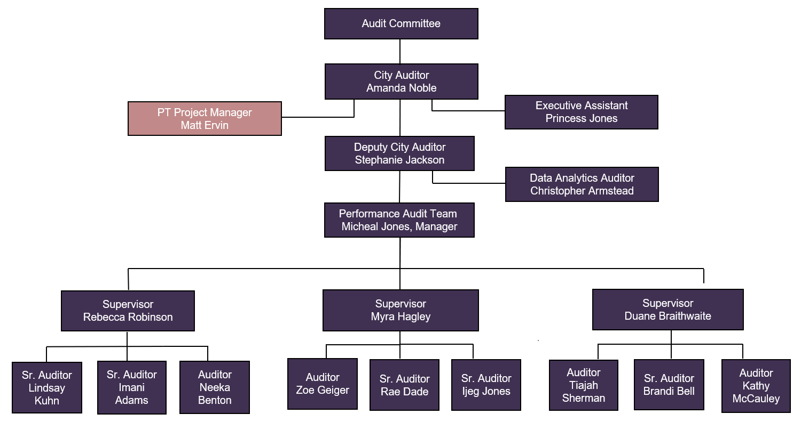
Organizational Chart

Slide 7
Questions?

