Slide 1
City Auditor’s Office
Quarterly Report to Finance/Executive Committee
October 11, 2023
Notes:
Good afternoon. I’m Amanda Noble, City Auditor, presenting our quarterly report for the first quarter of fiscal year 2024.

Slide 2
FY24 Q1 Summary
Audits
Follow-up
Continuous audit
1 audit released
9 audits in progress
FY24 annual audit plan under development
8 Recommendations Closed
6 (75%) Closed as Implemented
49 Advanced Access Control Conflict Pairs
13 Sensitive Access
25 Financial & HR Transactions
3 OTBI Reports
https://dashboard.missionmark.com/ae075fd7-a40b-489c-a67a-6e1ec4566694/
Notes:
This first slide summarizes our activity to date in the first quarter. We’ve released one audit report and have nine audits in progress that I’ll talk about in the next slides. The Audit Committee meets tomorrow to work on audit selection for new audits to start for the remainder of the fiscal year. Our goal is to release 12 audit reports this fiscal year, so we are a little off track.
We currently have 212 open audit recommendations; 101 have a status of started or partly implemented (48%). We closed 8 recommendations in the first quarter with 6 implemented for a 75% implementation rate. Based on benchmarking I’ve seen, that is in line with our peers. Our goal is to close 125 recommendations this fiscal year. Again, we are off track in terms of meeting the goal but are getting pretty good engagement with departments in providing updates. Not always in updating the database. We are working this year to add a prioritization to track the open recommendations.
On continuous audit, we have finished data clean-up on the procure-to-pay cycle, so we are monitoring Procurement and AP access controls and potential red flags. We’re developing a dashboard to report results and remediation. It is nearly done – it needs a little polishing before we publish. Both departments are paying attention. The Financial Services Team asked for a tool to use when evaluating requests for new user access and Procurement is looking at changing the process for creating suppliers for a single payment. We also run a query to match the city’s supplier table against the employee table on different fields and refer potential conflicts or problems to the Ethics Office/IG and/or Department of Procurement. We’re working on data clean-up in other business areas. As we complete clean-up, we’ll roll them into the dashboard.

Slide 3
Audits Completed
Audit | Status
1.Plane Train | Released August 2023

Slide 4
Audits In Progress
Audit | Status
Landscape Contracts | Audit Committee Review
Water & Sewer Billing and Collections | Management Review and Response
Moving Atlanta Forward Infrastructure Program | Technical Review
Procurement Cycle Time | Report Editing
Aviation Capital Projects | Report Editing
Municipal Court | Drafting Report
City Council Expenditures/Carry Forward | Fieldwork
Cybersecurity | Planning
Oracle Time and Labor | Interim Report to Mgt; Ongoing review
Notes:
These are the nine audits in progress.
The Audit Committee should be voting to release the Landscape Contracts audit tomorrow. Barring unforeseen events, the next five should be on the Audit Committee agenda for release in December, which means they would be presented in January.

Slide 5
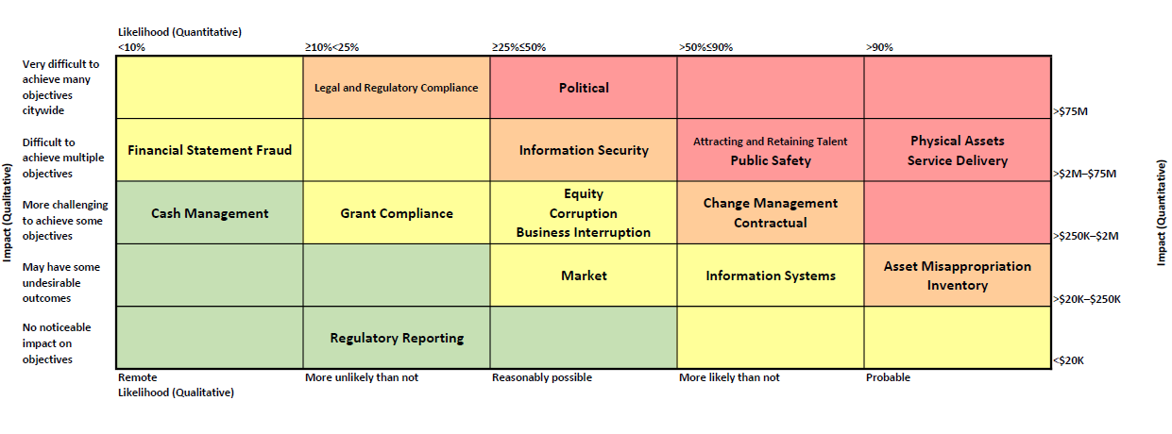
Risk Assessment For FY24 Audit planning
Notes:
This slide shows the results of our risk assessment for audit planning. We had hoped to conduct a workshop with the executive offices to get their input, but unfortunately couldn’t get that scheduled so this reflects our internal assessment. We started with a list of 20 risks and rated them based on likelihood – shown here on the horizontal axis – and potential impact – shown here on the vertical axis.
Based on our internal assessment, the highest risk areas for the city are in the red cells: physical assets, service delivery, attracting and retaining talent, public safety, and political. “Political” here refers to external events – “an unfavorable political environment creating, for example, secession movements, large-scale protests, adversarial relationship with state, etc.” Medium-to-High risk areas are in the orange cells: Legal and Regulatory Compliance, Information Security, Change Management, Contractual, Asset Misappropriation and Inventory.
This is a tool for the Audit Committee to use in considering additional audits to start this fiscal year.

Slide 6
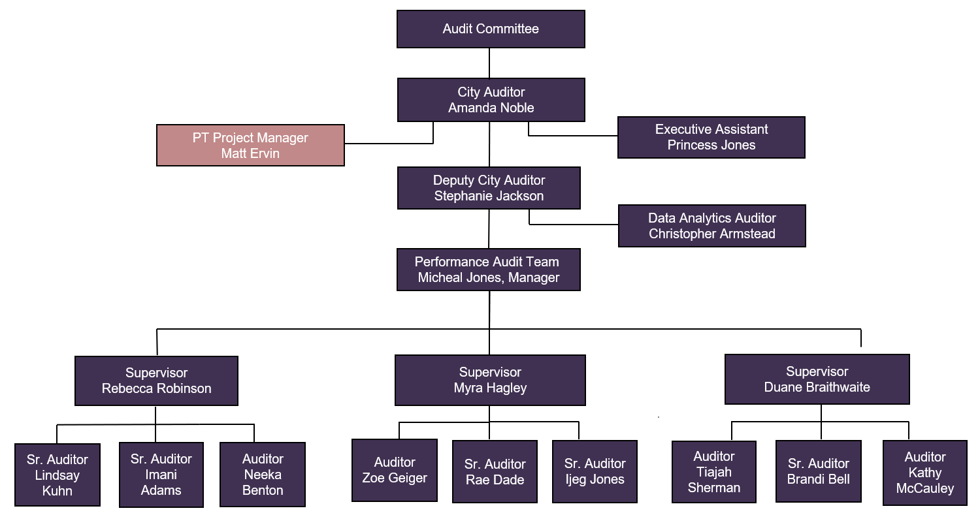
Organizational Chart
Notes:
This slide shows our organizational chart. We remain fully staffed.

Slide 7
Questions?

